Slide 1

Chat
Application.
Connecting All of Us with the World

Slide 2
Introduction
Chat applications have transformed the way we communicate in today's digital age.
From personal conversations to business collaboration, chat applications have become integral tools for connecting people worldwide.
In this presentation, we will explore the evolution, features, benefits, and impact of chat applications on modern communication.

Slide 3
Objective
When user clicks on a username from the list, a chat window opens where the user can type message and send. All the exchanged messages displayed in the scrollable area.
The chat application aims to provide a seamless and intuitive user experience, making it easy for users to navigate the interface, find contacts, initiate conversations, and access features. This involves user-friendly design, responsive layouts and efficient performance.

Slide 4

Project Module
Real-Time Communication
Implement real-time communication between users using JavaScript
Users should be able to select a chat room to join and exchange messages with other users in that room.
Messages should appear in real-time without the need to refresh the page.

Slide 5

User Interface
Create an intuitive and visually appealing user interface for the chat application using HTML and CSS.
Design a chat room interface with a list of available rooms, a message display area, and an input field for sending messages.
Ensure responsive design to accommodate different screen sizes.

Slide 6

Chat Features
Allow users to send text messages in chat rooms.
Provide a way to see who sent each message, and timestamp each message.
We can clear the previous messages in chat room.

Slide 7
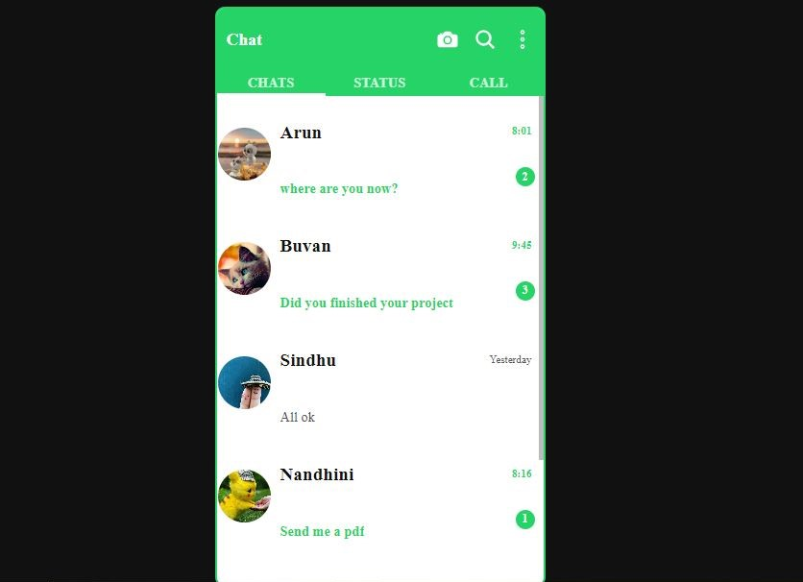
Project Images

Slide 8
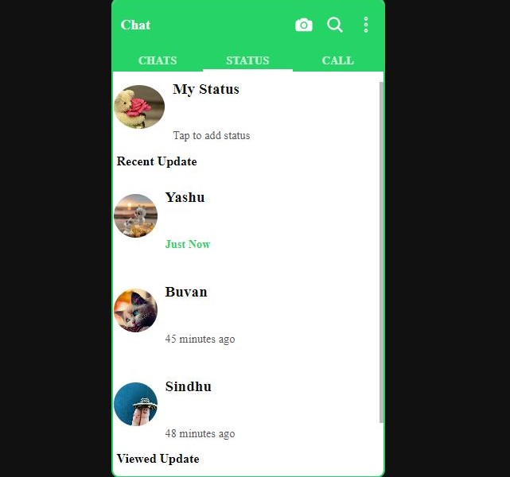

Slide 9
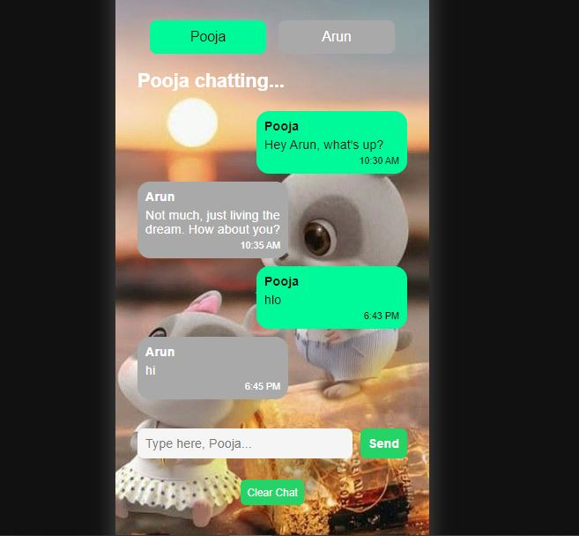

Slide 10
Conclusion
In conclusion, the chat application represents a powerful tool for connecting people, fostering collaboration, and enriching communication experiences in today's digital world.
Chat applications have transformed the way we communicate, enabling real-time conversations, enhancing collaboration, and fostering connectivity across distances.
Throughout this presentation, we have explored the evolution, features, benefits, and impact of chat applications on modern communication.

Slide 11
Thank You !

